Slide 1

4 on 4
Phase 4 Update for Palomar Amateur Radio Club
November 4, 2015
Notes:
This template can be used as a starter file to give updates for project milestones.
Sections
Sections can help to organize your slides or facilitate collaboration between multiple authors. On the Home tab, under Slides, click Section, and then click Add Section.
Notes
Use the Notes pane for delivery notes or to provide additional details for the audience. You can see these notes in Presenter View during your presentation.
Keep in mind the font size (important for accessibility, visibility, videotaping, and online production)
Coordinated colors
Pay particular attention to the graphs, charts, and text boxes.
Consider that attendees will print in black and white or grayscale. Run a test print to make sure your colors work when printed in pure black and white and grayscale.
Graphics, tables, and graphs
Keep it simple: If possible, use consistent, non-distracting styles and colors.
Label all graphs and tables.

Slide 2



Phase 4
A digital microwave geosynchronous amateur radio satellite service system made possible by a partnership between Virginia Tech, AMSAT, and Millennium Space Systems.
Notes:
What is the project about?
Define the goal of this project
Is it similar to projects in the past or is it a new effort?
Define the scope of this project
Is it an independent project or is it related to other projects?
* Note that this slide is not necessary for weekly status meetings

Slide 3
The AMSAT Phase System Explained
Phase 1
Phase 2
Phase 3
Phase 4
Phase 5
battery-powered only, short-lived, technology test-bed
LEO with comms and solar panels
Elliptical orbit, with telemetry and control
GEO!
Lunar or planetary
Ascent Project
Phase 4 Project

Slide 4
Phase 4 – Not Just a Satellite Project
Satellite Service
Terrestrial Service
This mission (Phase 4b) is funded for three years, and could last for ten. The satellite may be placed in a parking orbit. We are hoping to build upon this mission in order to have our own geosynchronous satellite(s) with longer missions.
Phase 4a is a AMSAT-DN project.
Using the launch as a motivator, we will create ground stations and equipment that will live on past the satellite mission. Terrestrial service is built-in from the beginning. The system will be fun, useful, reconfigurable, powerful, and will make getting on the microwave bands much easier and much more accessible than they have been in the recent past. Use them or lose them!

Slide 5
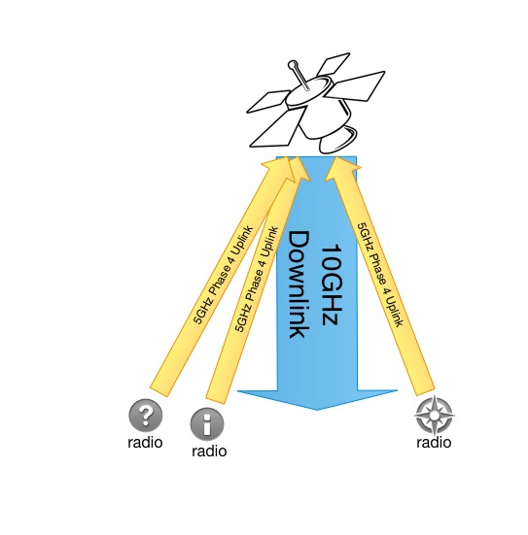
Phase 4 radios
5.645-5.655 GHz up
10.45-10.46 GHz down

Slide 6
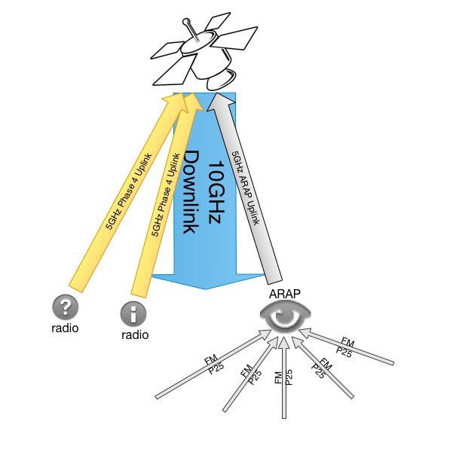
Phase 4 radios
5.645-5.655 GHz up
10.45-10.46 GHz down
ARAP

Slide 7
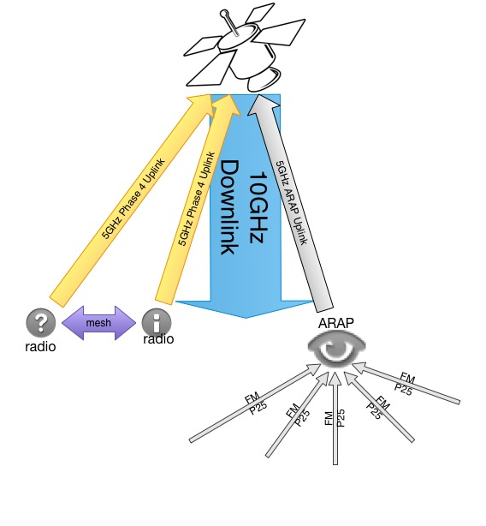
Phase 4 radios
5.645-5.655 GHz up
10.45-10.46 GHz down
5 GHz local mesh
ARAP

Slide 8



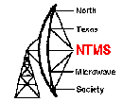
Who else is directly supporting this project?
Palomar Amateur Radio Club, Escondido Amateur Radio Society, Dixon Lake Recreation Area, Rincon Research, North Texas Microwave Society, Federal Emergency Management Agency, Ettus Research, Hume Center at VT, Amateur Radio Relay League…
Notes:
There’s a lot of support

Slide 9
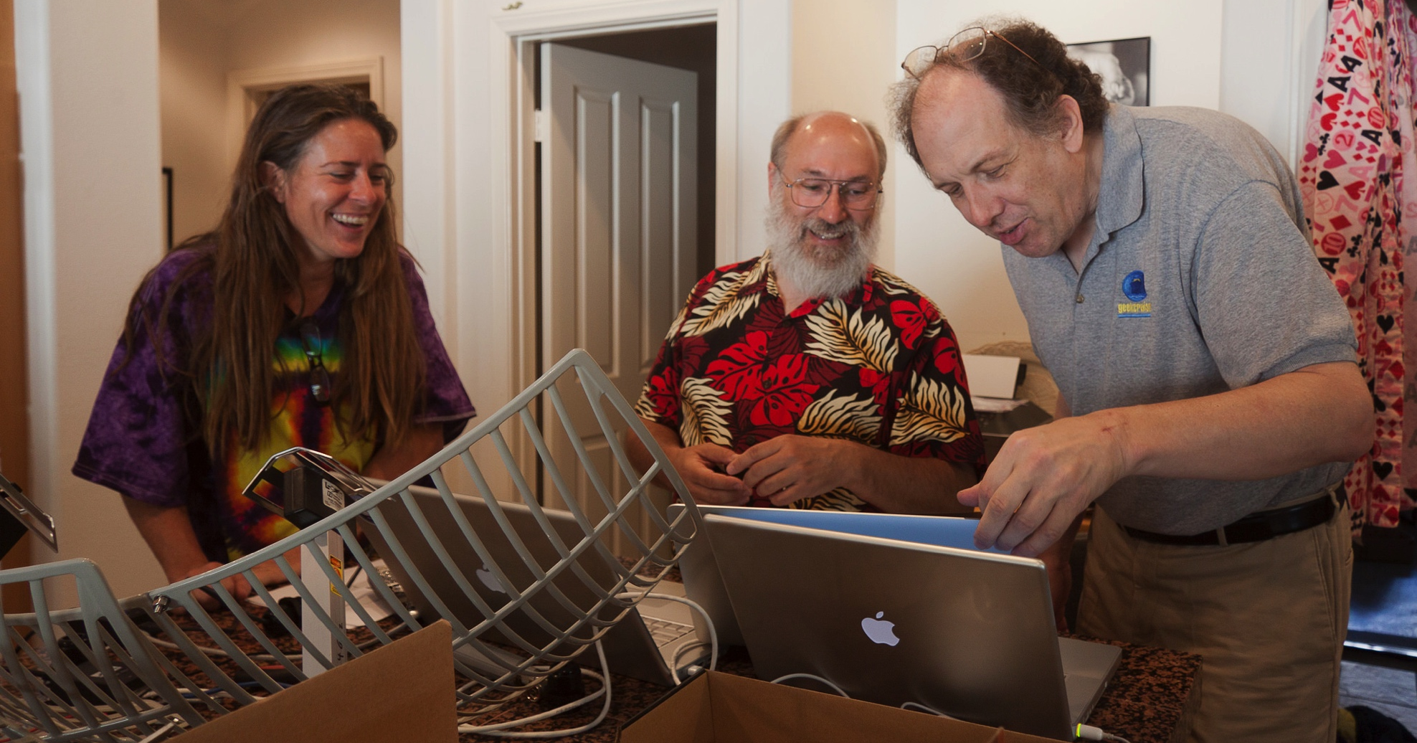
And lots of volunteers!

Slide 10
Current Status
We have a growing team of 40 volunteers/employees
A $100,000+ rideshare payload study at MSS is underway
We are expecting a late 2016 or early 2017 launch
We will have 100 watts of power from the spacecraft
We will enjoy access to the coldplate
We can use several external areas on the spacecraft for antennas
We do not have to control the spacecraft
Ground station development is completely open source
Space segment development is ITAR controlled
Notes:
35 volunteers from across the US and Canada
The study at Millennium Space Systems is to make sure that the amateur radio payload will not interfere in any way with the primary mission, and to confirm what spacecraft resources we will have access to.

Slide 11
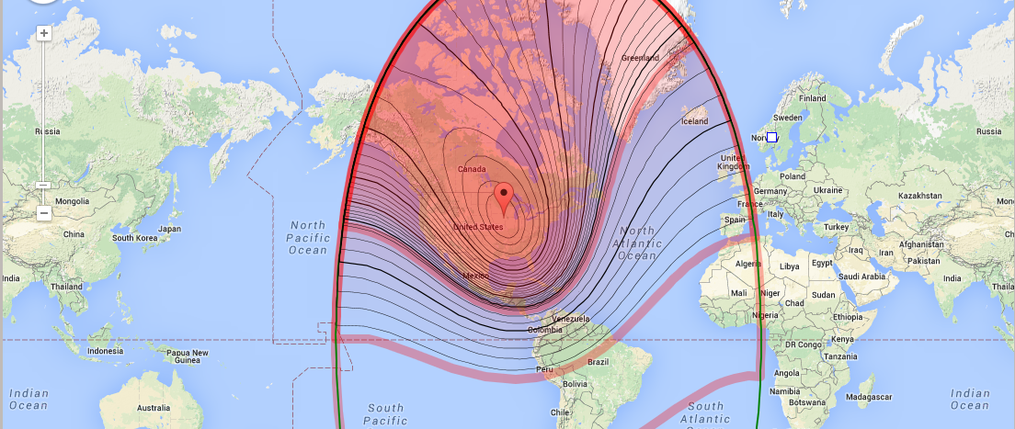
Possible Satellite Footprint – 74∘ W

Slide 12
Wide Field of View Connections
WFOV
MSS
Air Force
Jeff Ward K8KA
Col Fred Kennedy
University of Surrey
University of Surrey
AMSAT
TAPR

Slide 13
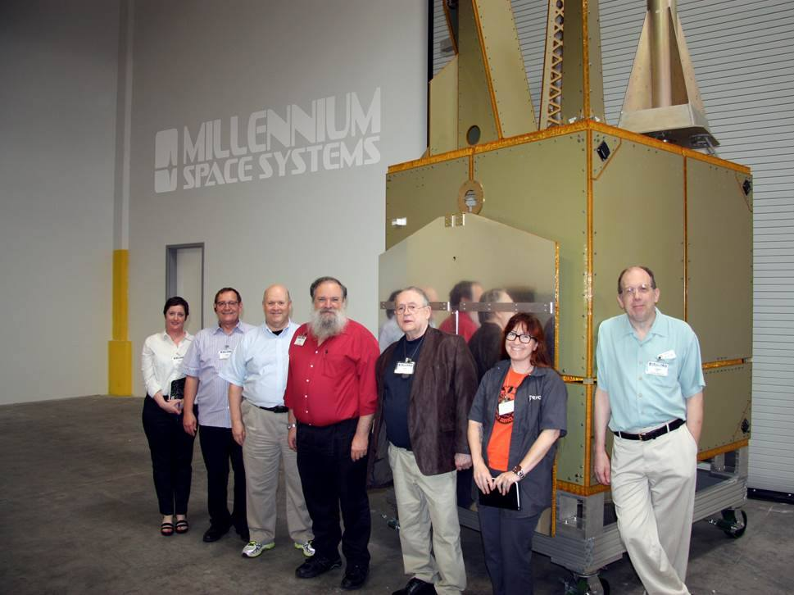

Slide 14
Millennium Space Connections …are actually SpaceDev Connections
SpaceDev
(built ChipSat)
Stan Dubyn
CEO MSS
Jan King W3GEY
AMSAT
Bob Davis KF4KSS

Slide 15
Rincon, TAPR, and the LPFE
Rincon has donated their LPFE (similar to USRP E310) for the Phase 4 spacecraft.
It’s on the internet via VPN for programming.
Rincon will also donate an LPFE for Phase 3E.
Rincon, TAPR
Mike Parker KT7D
Tom Clark K3IO
Bob N4HY

Slide 16
Issues and Resolutions
International Traffic in Arms Regulations directly affects this project
What and how did it impact the project?
Time wasted, stress increased, harsh and unnecessary limits on human resources
Splitting up the project into Ground and Space allowed for open source development of the ground station while enabling the space segment development to continue to comply with ITAR.
Teams are now separate and communicate through the Air Interface Document, which defines the radio link between satellite and stations on the ground.
Notes:
ITAR (International Traffic in Arms Regulations) and the EAR (Export Administration Regulations) are export control regulations run by different departments of the US Government. Both of them are designed to help ensure that defense related technology does not get into the wrong hands. Satellites are a controlled technology.

Slide 17

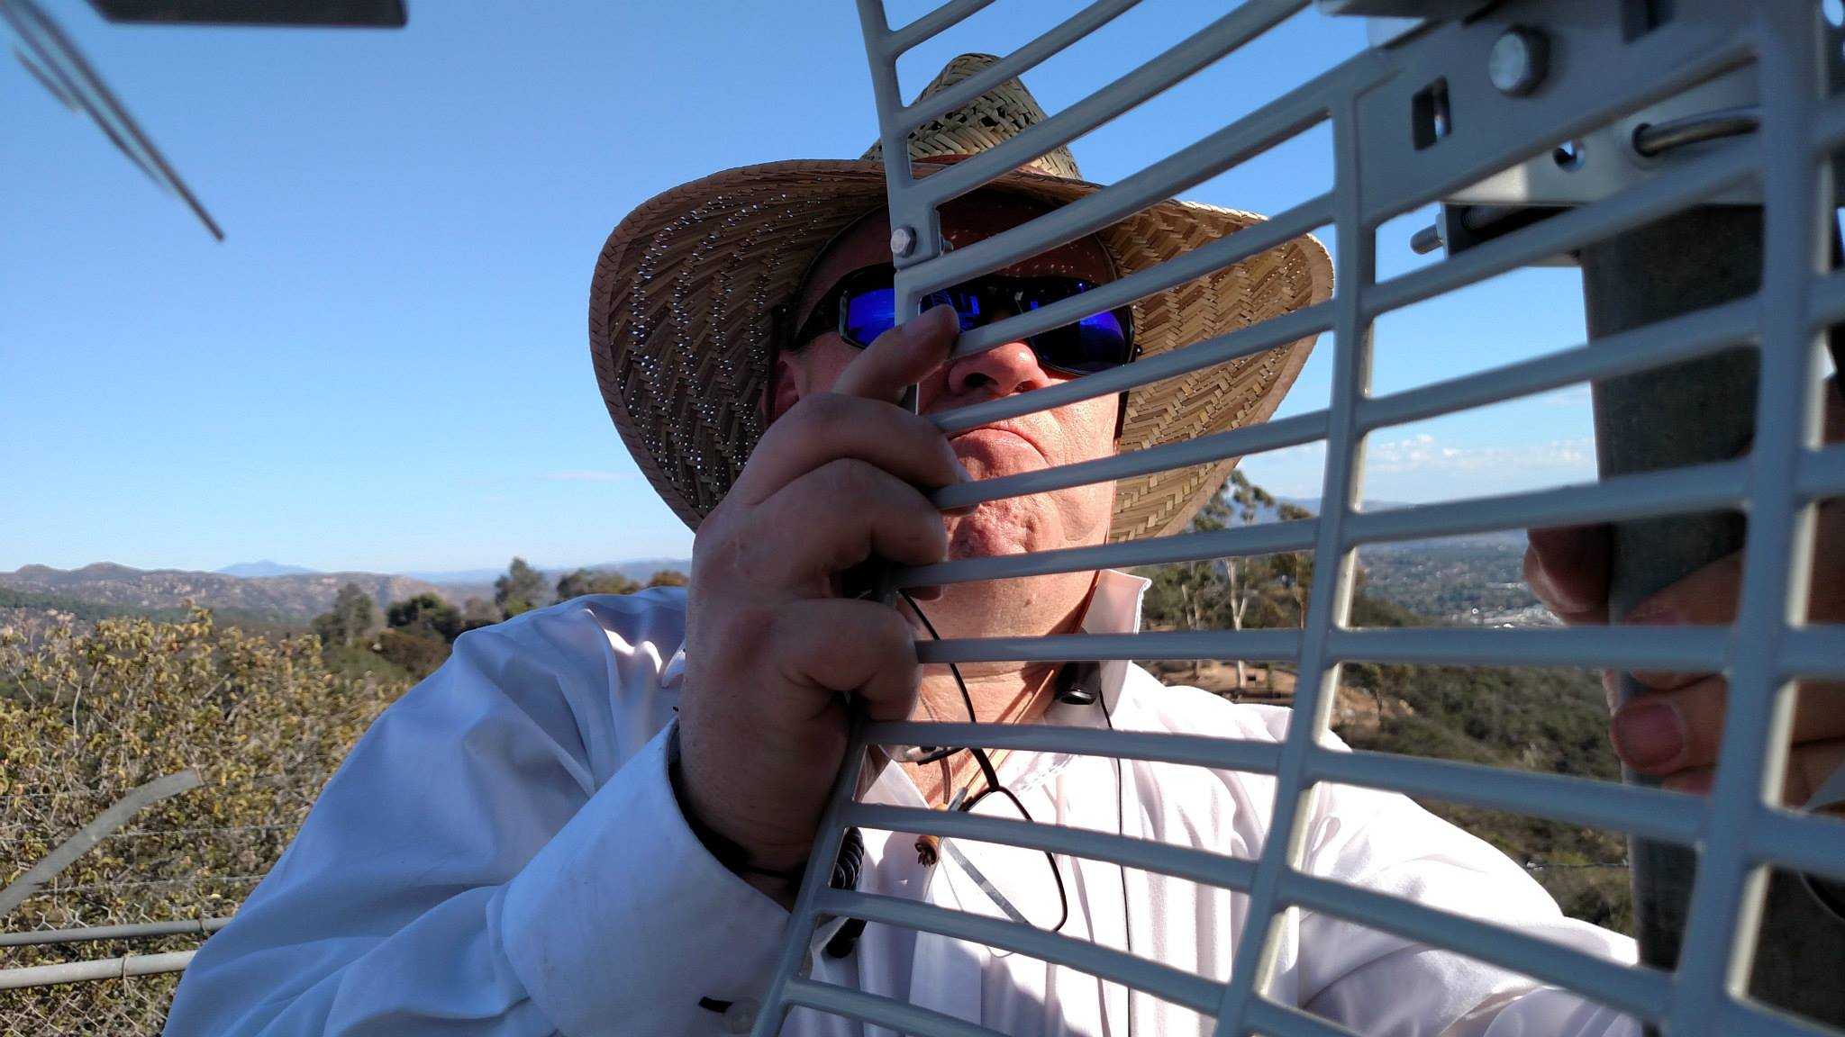
Phase 4 Top-level Team Structure
Common Air Interface
Phase 4 Ground Team
Phase 4 Space Team
https://github.com/phase4ground
Notes:
United through github!

Slide 18

Phase 4 Ground Team Structure

Slide 19
It’s All About The Team
RF Hardware
5GHz link
Applications
QSO party
Digital Hardware
USRP prototyping
Host spec
Mesh radio interface
10GHz link
Antennas
SatChat 1k
Servers
Xmpp
YAWS
Authentication
EmComm
Stereo Field
FractalQSL

Slide 20
Phase 4 Ground Leadership Supports the Team
helps
Michelle W5NYV
Ground Team Lead
helps
Bill Reed
AMSAT Project Manager
helps
Jerry
AMSAT VPE
helps…
Bob N4HY
Director of Research at Hume Center VT

Slide 21
Development System
Groundsat
ARAP
User Terminals

Slide 22

Groundsat

Slide 23
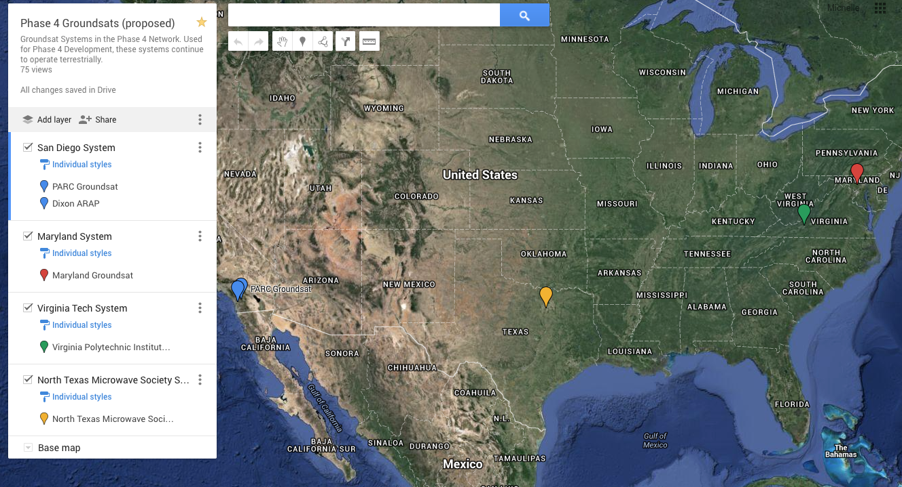
Groundsat sites are planned in four US locations with a variety of weather and geography.

Slide 24
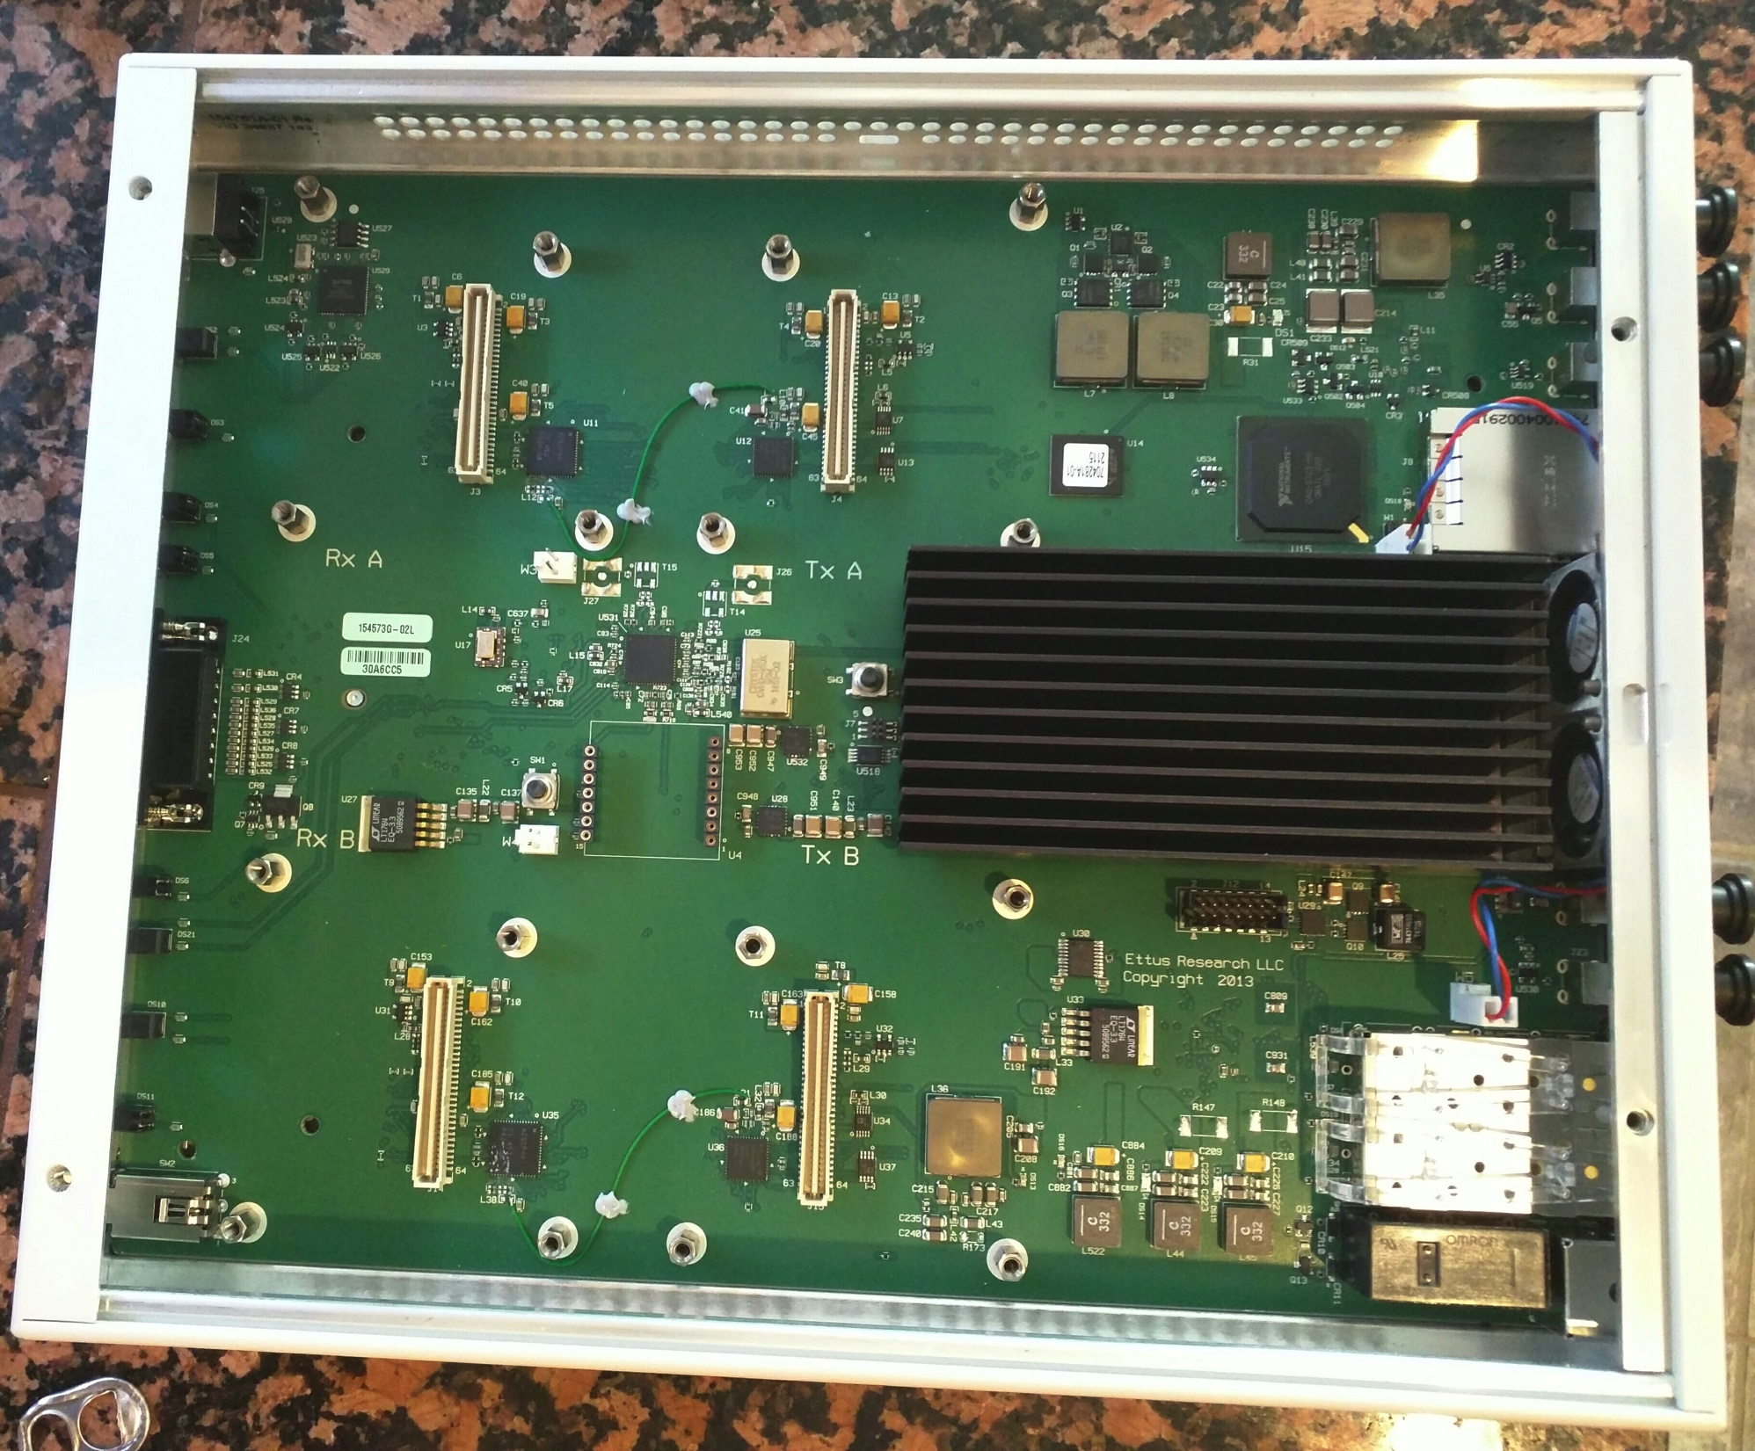
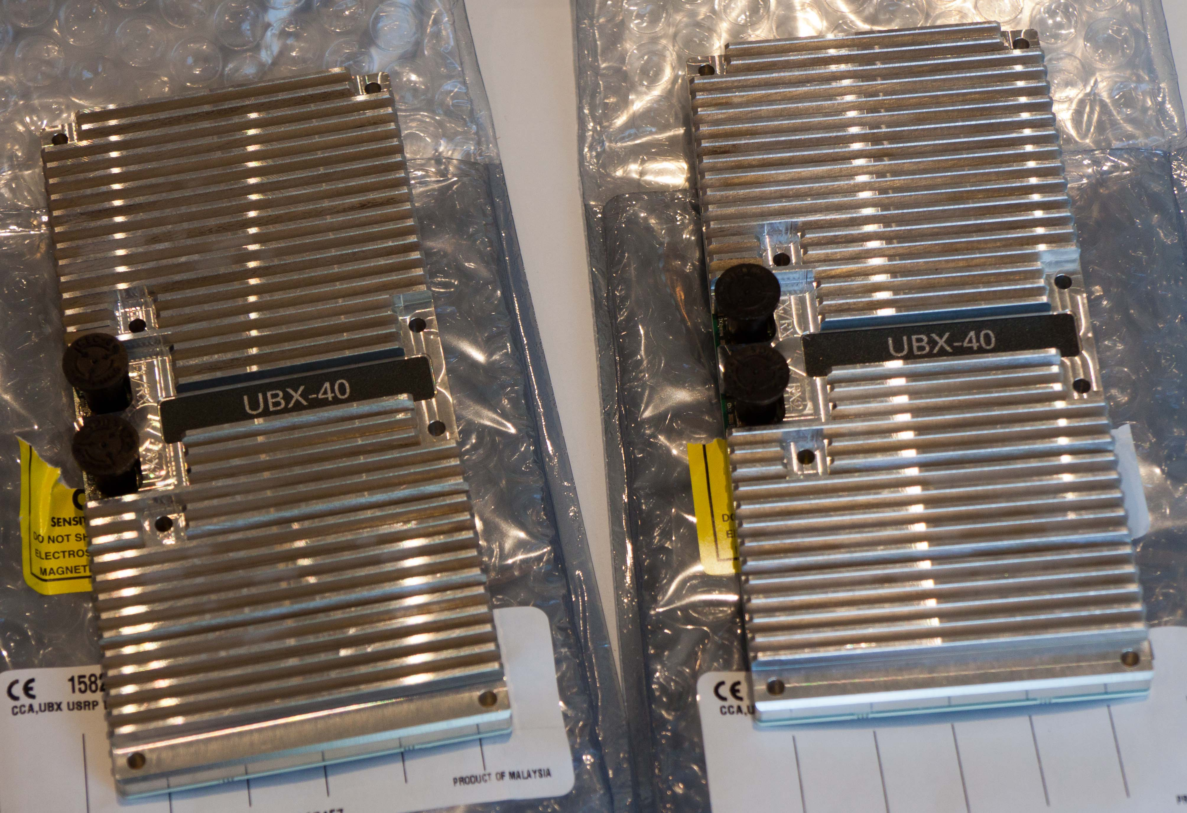
USRP* X310 and 10MHz – 6GHz RF daughter cards. This will simulate the FDMA demodulator and TDM modulator functions provided by the satellite.
*Universal Software Radio Peripheral

Slide 25
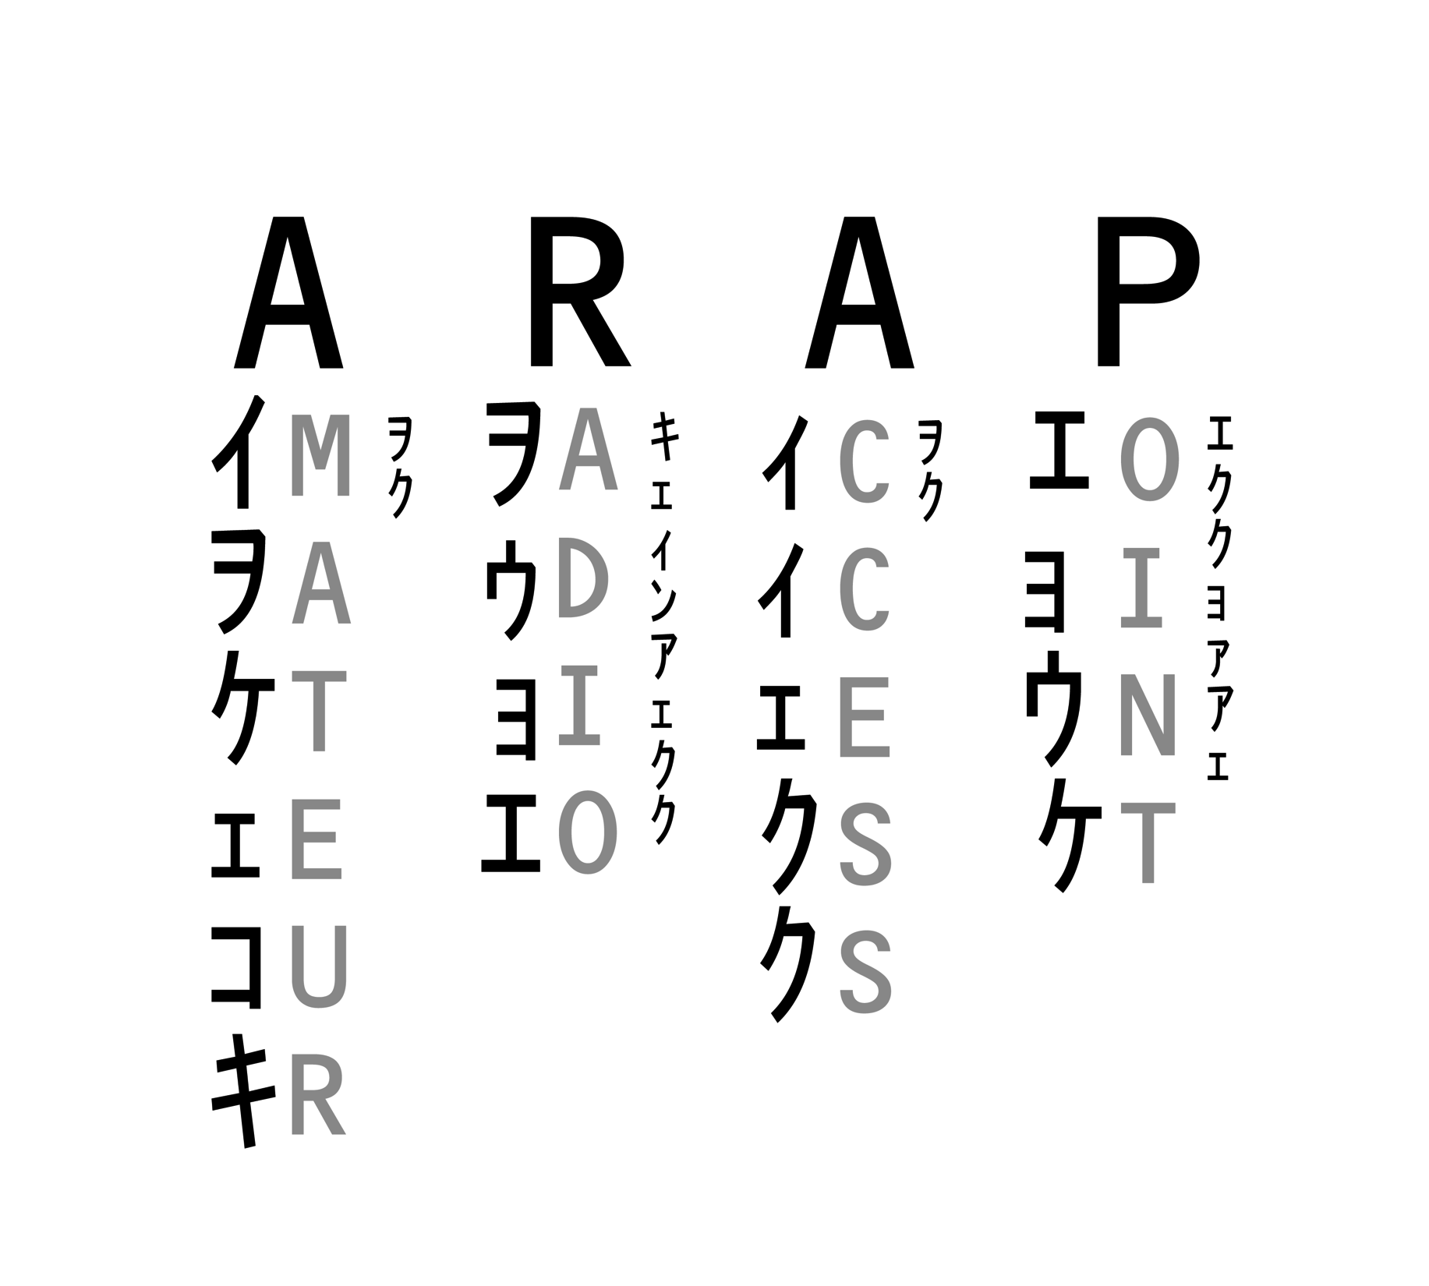

Slide 26
Amateur Radio Access Points
Amateur Radio Access Points (ARAPs) aggregate radio traffic and send it to the satellite. They are powerful mobile stations that can provide emergency communications out of an affected area to either a satellite or Groundsat.
The goal is for emergency or credentialed personnel to use their own radio gear.
During a communications emergency, shared secrets allow for control of access to the satellite uplink.

Slide 27
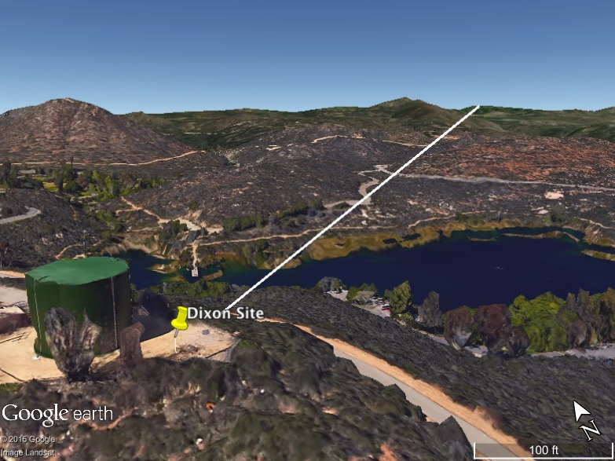

Slide 28
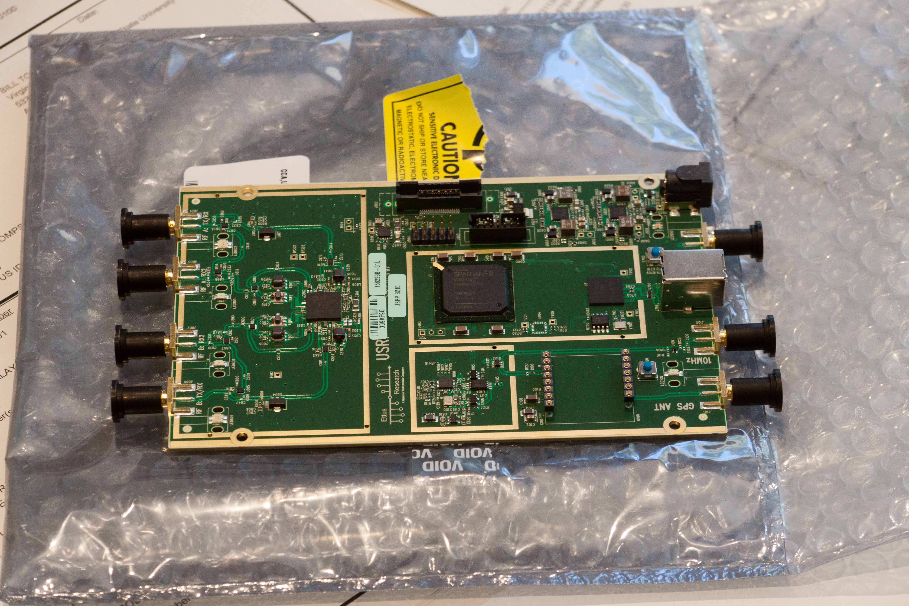
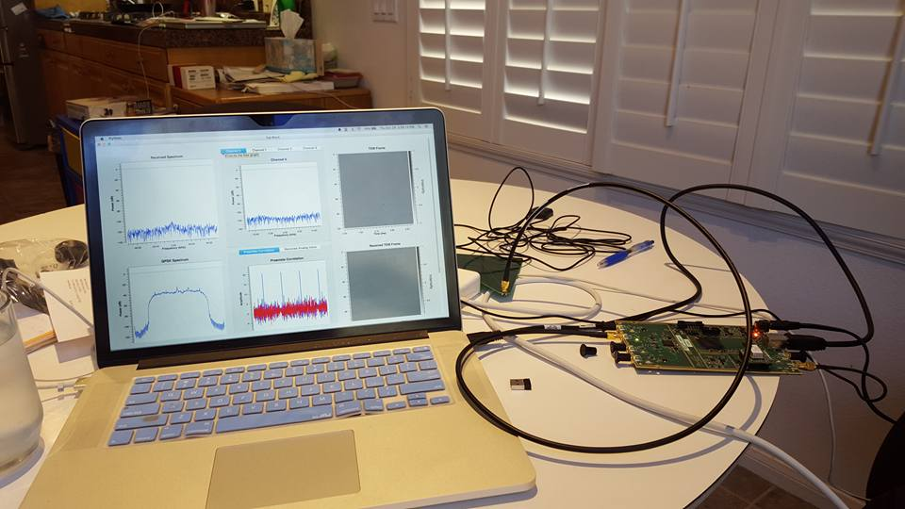
USRP B210 set up to demonstrate an ARAP collecting local FM traffic.
First demonstration was made at the AMSAT Symposium on 18 October 2015.
At left is same code running in San Diego on 30 October 2015.

Slide 29
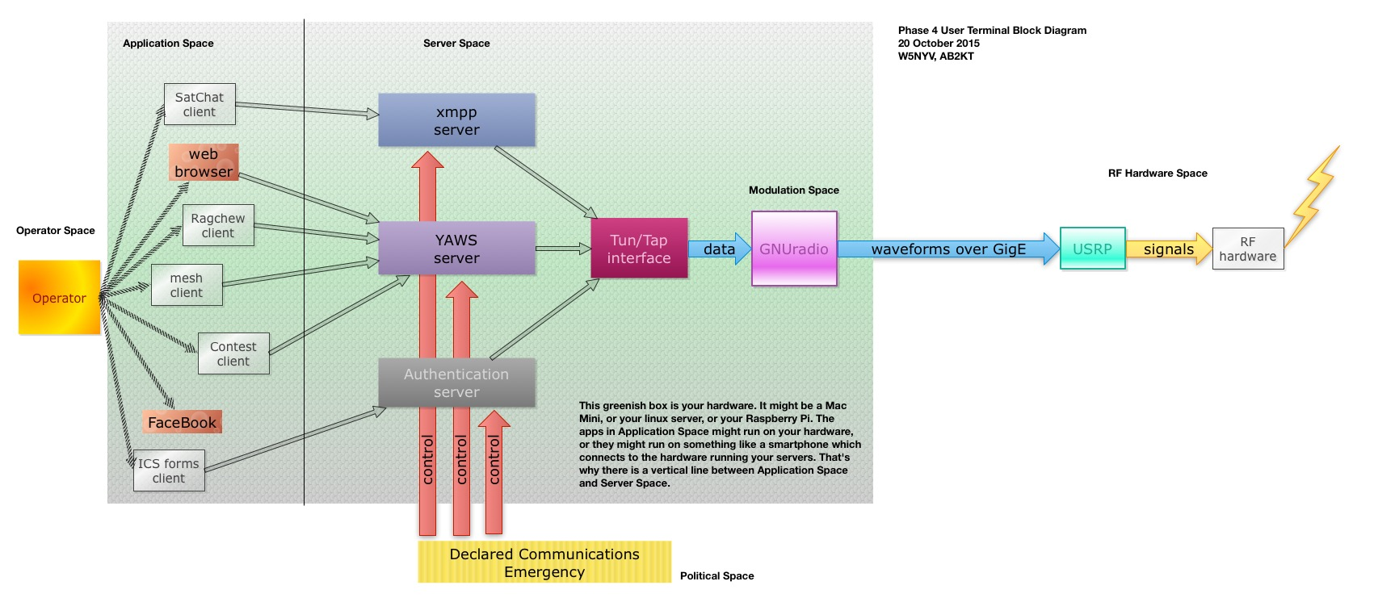
User Terminals… are still a block diagram

Slide 30
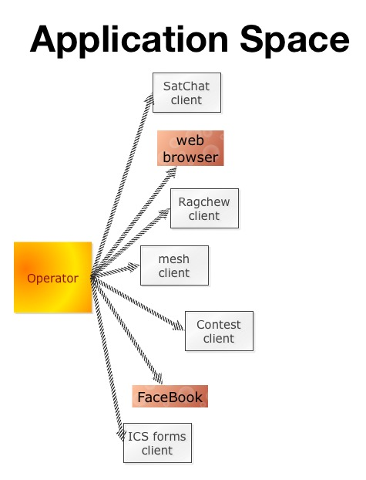
But, we have a great block diagram that has survived its first review.

Slide 31
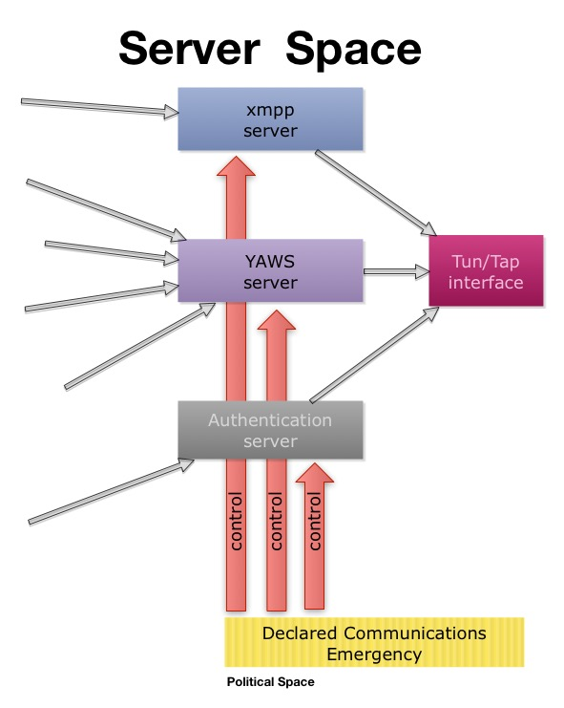

Slide 32
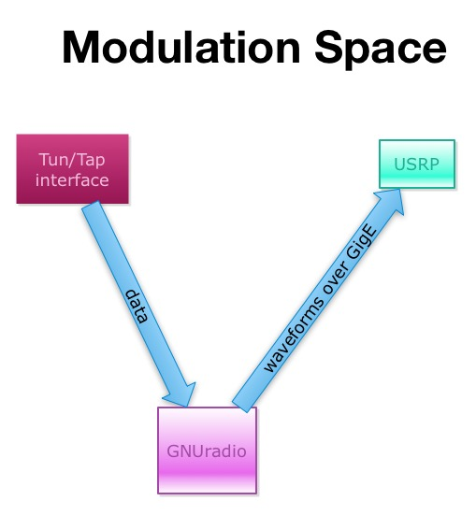

Slide 33
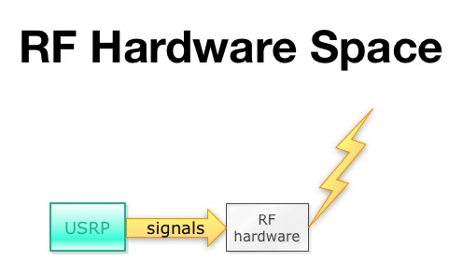

Slide 34
Contact Phase 4 Ground
https://github.com/phase4ground (team of 15 not visible)
phase4@amsat.org (apply for membership to this address, open to both US and non-US citizens)
Contact Michelle w5nyv@yahoo.com for more information.
Contact Phase 4 Space
Due to ITAR, both the repository and the mailing list are closed, invite-only, and restricted to US citizens only.
Contact Jerry Buxton vpe@amsat.org for more information.

Slide 35


Slide 36
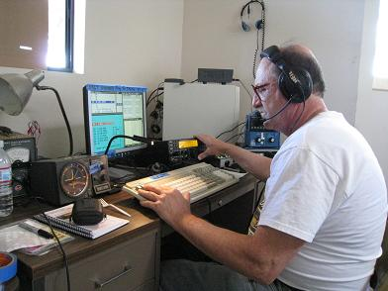
Complaints Lead:
N6KI

